Slide 1
Object-Oriented Programming (OOP)
OOP is like building with LEGO:
Each LEGO piece = Object (it has shape, colour, purpose)
LEGO instructions = Class (blueprint to create objects)

Slide 2
Object-Oriented Programming (OOP)
Key OOP ideas:
Class – blueprint (e.g., “Car” design)
Object – actual item made from the blueprint (e.g., a Toyota Corolla in Sydney)
Attributes – properties (e.g., colour, model)
Methods – actions (e.g., start engine, honk)

Slide 3
Object-Oriented Programming (OOP)
Australian Example:
Class: Kangaroo
Objects: Red Kangaroo, Eastern Grey Kangaroo in NSW
Attributes: tailLength, weight
Methods: hop(), eatGrass()

Slide 4
Object-Oriented Programming (OOP)
OOP Concept | Real-world Analogy | Australian Example
Class | Building design | "Opal Tower" plan in Sydney
Object | Actual building | Completed Opal Tower
Attributes | Room size, colour | Apartment floor plan
Methods | Actions | Lift moves, lights turn on

Slide 5
Object-Oriented Programming (OOP)
Why do modern apps in Australia (e.g., MyGov, Service NSW) use OOP rather than procedural programming?
Because OOP allows reusable code, easy maintenance, and modelling of real-world services like forms, accounts, and processes.

Slide 6
Object-Oriented Programming (OOP)
Why does Commonwealth Bank’s NetBank use OOP principles instead of procedural programming for its online banking platform?
OOP lets developers create reusable classes like Account, Transaction, and Customer, so features such as viewing statements or transferring money can be reused across mobile and web apps. It also makes it easier to maintain security, adapt to new regulations (like ASIC compliance), and roll out new services such as PayID without rewriting large parts of the system.

Slide 7
Object-Oriented Programming (OOP)
Australian Real-World Analogy Think of NetBank as a shopping centre:
Classes = store blueprints (e.g., Woolworths, JB Hi-Fi)
Objects = actual store branches in the centre
Updating one blueprint updates all branches — just like updating one class in OOP updates all relevant objects in the system.

Slide 8
Hands-On Activity 1 (CBA_BankAccount_Deposit in Python)
Write a class BankAccount in Java or Python with:
Two attributes: account_holder and balance
One method: deposit(amount) that increases the balance and prints the new balance

Slide 9
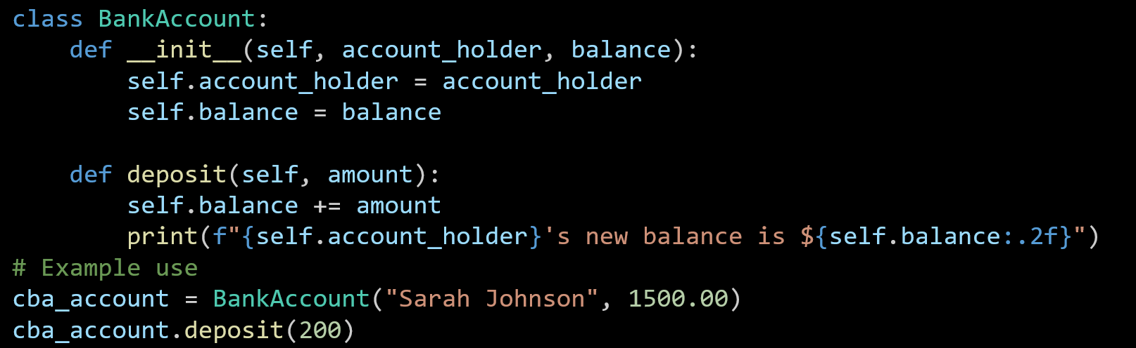
Hands-On Activity 1 (CBA_BankAccount_Deposit in Python)
The BankAccount class is created with two attributes: the account holder’s name and their balance.
The deposit method adds money to the balance and shows the updated amount.
An example account for Sarah Johnson is created, and $200 is deposited to update her balance.

Slide 10
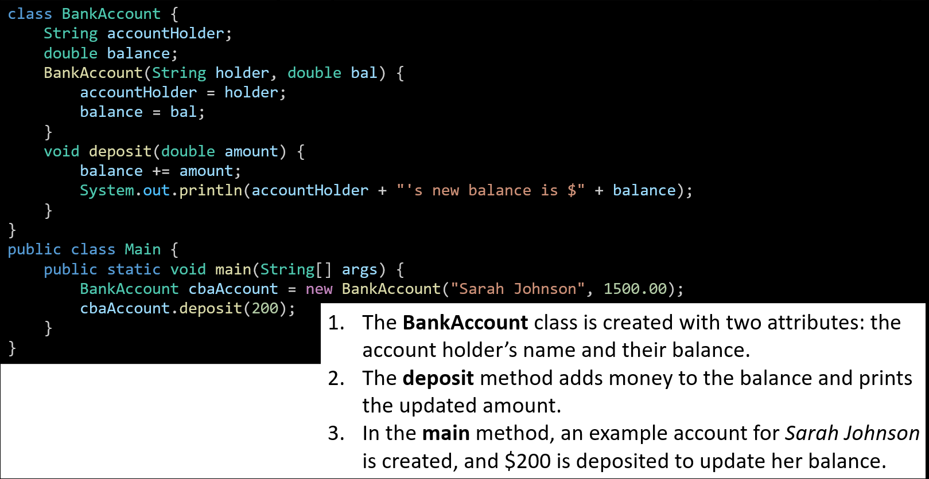
Hands-On Activity 1 (CBA_BankAccount_Deposit in Java)
The BankAccount class is created with two attributes: the account holder’s name and their balance.
The deposit method adds money to the balance and prints the updated amount.
In the main method, an example account for Sarah Johnson is created, and $200 is deposited to update her balance.

Slide 11
Hands-On Activity 2 (Create Multiple Bank Accounts and Call Their Methods) – Python
Write a Python program that:
Creates a BankAccount class with attributes for account holder name, account number, and balance.
Adds methods to deposit() money and show_balance().
Creates two different bank account objects (e.g., for two Australian customers) and calls their methods to deposit money and display balances.

Slide 12
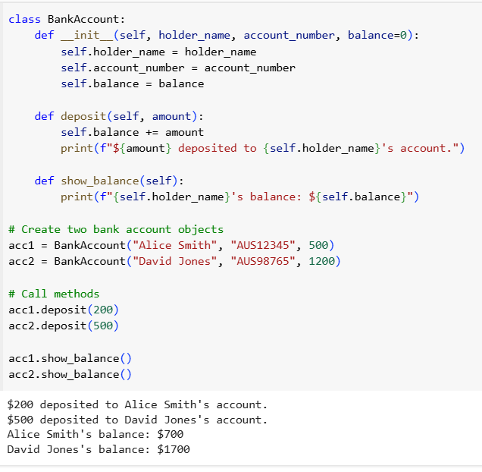
This code creates two Australian bank account objects and lets you deposit money into them and check their balances.

Slide 13
1. Class
BankAccount – a blueprint for creating bank account objects.
2. Attributes (data about the object)
holder_name → name of the customer
account_number → unique account ID
balance → how much money is in the account
3. Methods (actions the object can do)
deposit(amount) → add money to the account
show_balance() → display the current balance

Slide 14
4. Objects (real examples from the class)
acc1 → Alice Smith’s account with $500 starting balance
acc2 → David Jones’ account with $1,200 starting balance
5. Process
Create the two accounts.
Deposit money into each account.
Show the updated balances.

Slide 15
6. Key idea
Even though acc1 and acc2 are different accounts, they are built from the same class and can do the same actions (deposit, show_balance).

Slide 16
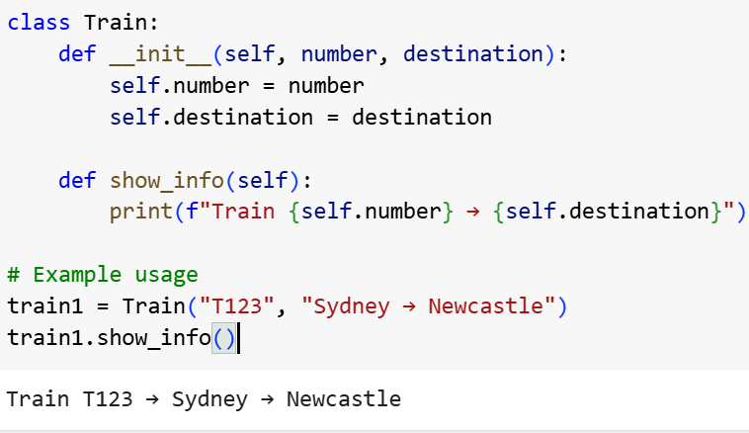
Hands-On Activity 3 (OOP Example – Train Class) in Python
Build a class Train that can show the train number and destination (e.g., Sydney → Newcastle).
This creates a Train1 object with its number and destination, then displays them in the desired format.

Slide 17
Hands-On Activity 3 (OOP Example – Train Class) in Python
Build a class Train that can show the train number and destination (e.g., Sydney → Newcastle).
class Train – creates a blueprint for trains.
__init__ method – runs when a train is made, storing its number and destination.
show_info method – prints the train’s details (number and where it’s going).
Example use – we make a train (T123 from Sydney to Newcastle) and call show_info() to display it.

Slide 18
Hands-On Activity 3 (OOP Example – Train Class) in Python
Class = the blueprint (Train)
Object = something built from the blueprint (train1)
Attributes = data stored inside the object (number, destination)
Methods = actions the object can do (show_info)

Slide 19
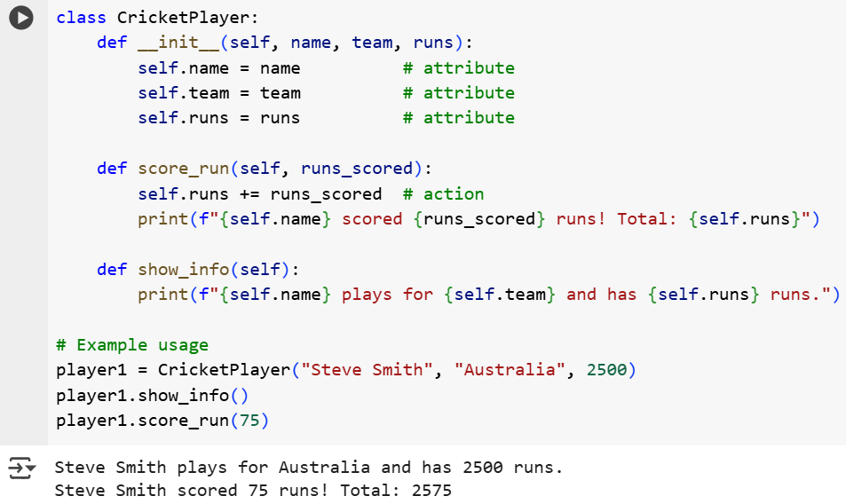
Hands-On Activity 4 (Create Your Favourite Aussie Sport Class) in Python
Create a class for a favourite Aussie sport (e.g., CricketPlayer) with attributes and actions.
Attributes: name, team, runs → facts about the player.
Actions (methods): score_run() and show_info() → what the player can do.

Slide 20
Data Types, Variables, and Operators
Variables are like containers that store information.
Python: Flexible – you can put anything inside.
Java: Strict – each container has a label for the type it can hold.

Slide 21
Data Types, Variables, and Operators
These types are explicitly defined in Java, but Python handles them differently:
Java: We must declare the type (int age = 25;) – it’s strictly typed.
Python: We don’t declare the type (age = 25) – it’s dynamically typed, but those kinds of values still exist.
Common types:
int – whole numbers
float / double – decimals
boolean – true/false
char – one letter
String – text

Slide 22
Data Types, Variables, and Operators
So:
In Java, int, double, boolean, char, and String are actual type keywords (except String, which is a class).
In Python, the variable type is inferred automatically, but it still stores integers, floats, booleans, strings, etc. (char isn’t a separate type; it’s just a string of length 1).
Common types:
int – whole numbers
float / double – decimals
boolean – true/false
char – one letter
String – text

Slide 23
Data Types, Variables, and Operators
Australian Example:
Temperature in Sydney: float
Number of trams in Melbourne: int
Is it a public holiday in NSW? boolean
Type | Python Example | Java Example
int | age = 25 | int age = 25;
float/double | price = 4.5 | double price = 4.5;
boolean | sunny = True | boolean sunny = true;

Slide 24
Data Types, Variables, and Operators
Discussion Question: Why is it important to choose the correct data type for Australian weather data?
Correct types ensure accurate storage and calculations, e.g., temperature needs decimals for precision

Slide 25
Hands-On Activity 5: Data Types, Variables, and Operators
Declare and print three variables for your suburb’s name, current temperature, and if it’s raining. (in python and java)

Slide 26
Hands-On Activity 5: Data Types, Variables, and Operators
Python
suburb = "Castle Hill"
temperature = 22.5
is_raining = False
print(suburb, temperature, is_raining)

Slide 27
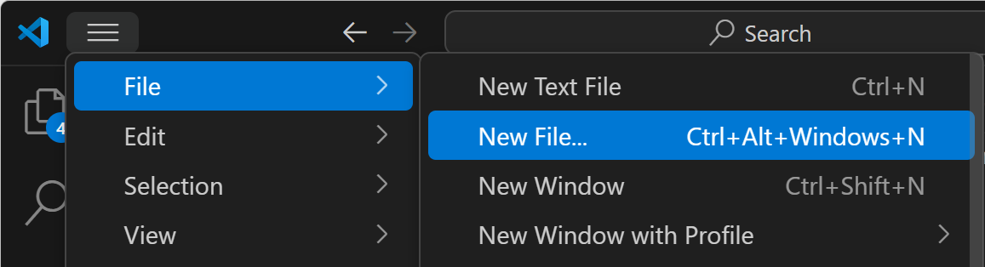
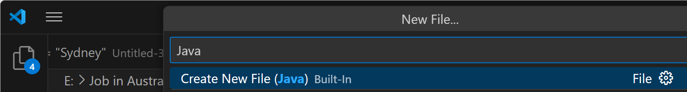
Hands-On Activity 5: Data Types, Variables, and Operators
Java
In Java, all code that runs must be inside a method, usually the main method, and inside a class.

Slide 28
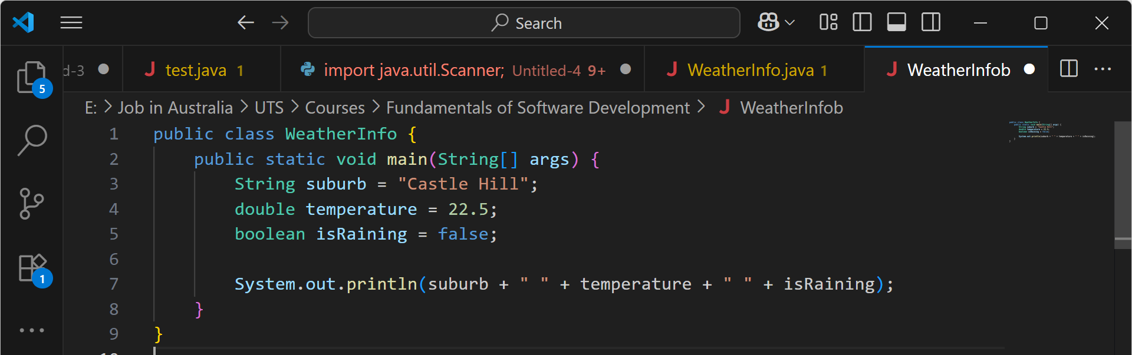
Hands-On Activity 5: Data Types, Variables, and Operators
This Java program stores a suburb name, its temperature, and whether it’s raining, then prints them all together on one line. It’s a simple Java example showing variables of different data types and basic output.

Slide 29
Strings & String Formatting
String = text data.
Formatting = inserting variables into text.
Think of it like a fill-in-the-blank postcard.
Australian Example:
"Welcome to {}!" → "Welcome to Sydney!"

Slide 30
Strings & String Formatting
Python Example:
city = "Sydney"
print(f"Welcome to {city}!")

Slide 31
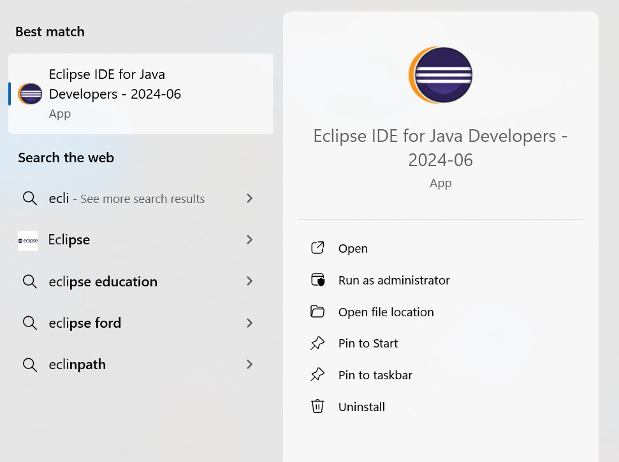
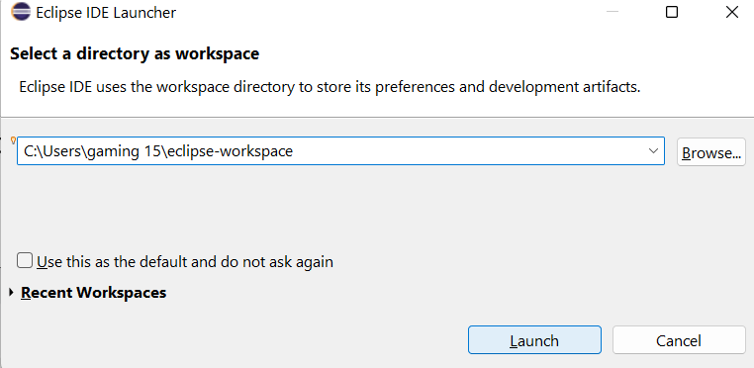
Strings & String Formatting
Java Example in Eclipse:

Slide 32
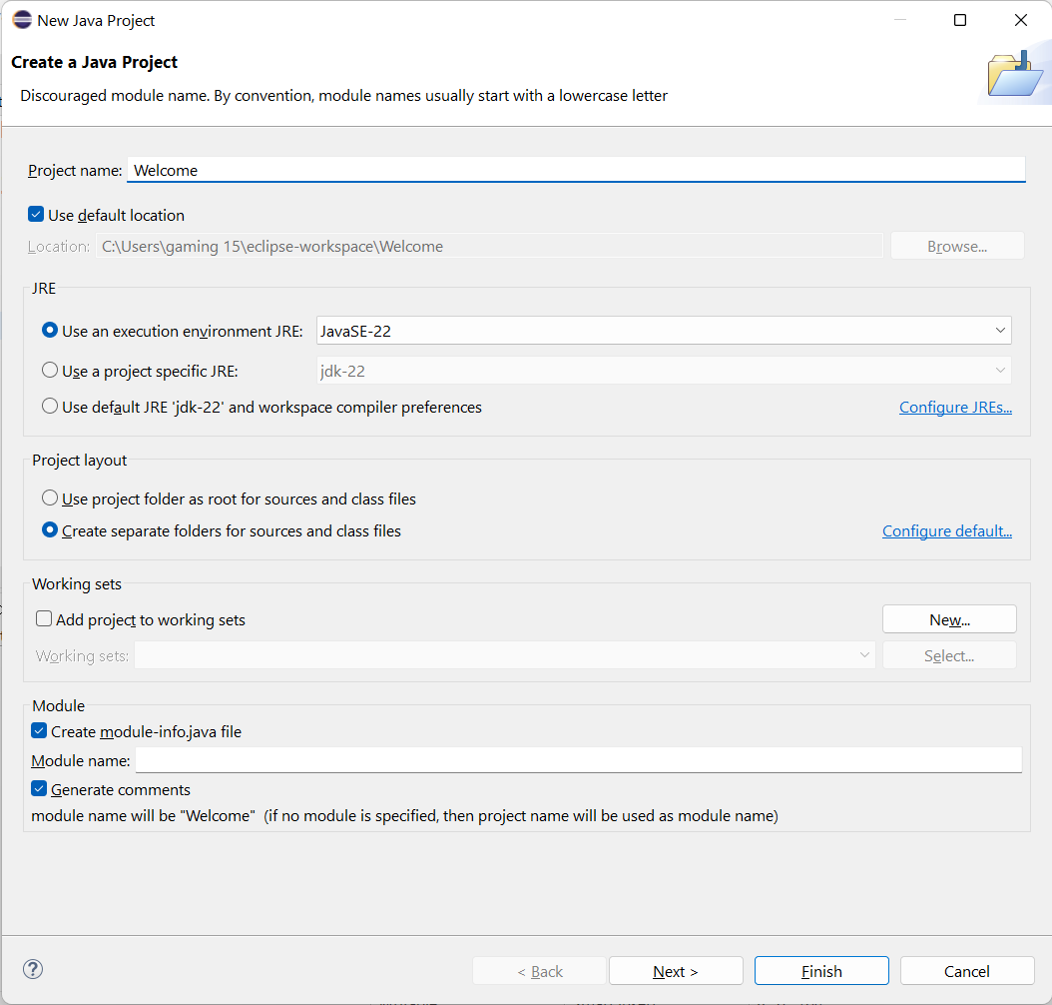
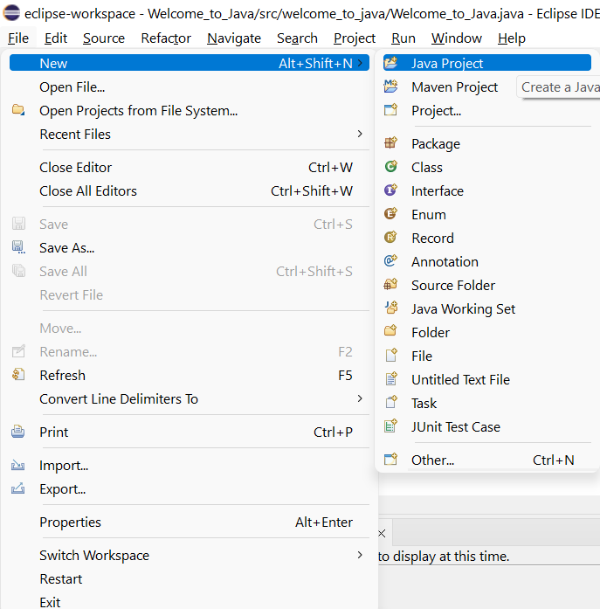
Strings & String Formatting
New Java Project in Eclpise

Slide 33
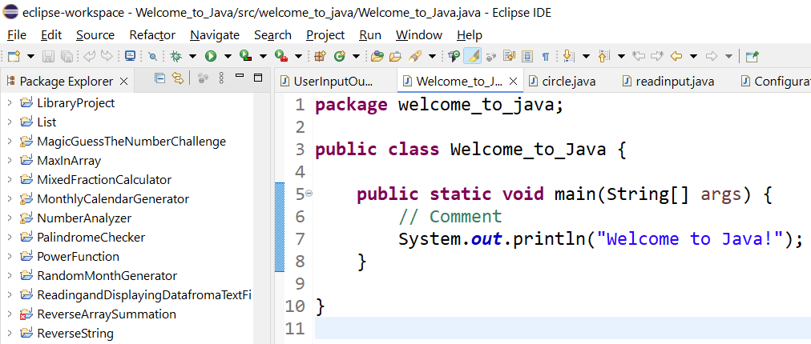
Java Code
package welcome_to_java; – Groups this class into a package called welcome_to_java.
public class Welcome_to_Java { ... } – Defines a public class named Welcome_to_Java.
public static void main(String[] args) – The entry point where the program starts running.

Slide 34
Java Code
// Comment – A note for humans, ignored by the computer.
System.out.println("Welcome to Java!"); – Prints the message Welcome to Java! on the screen.

Slide 35
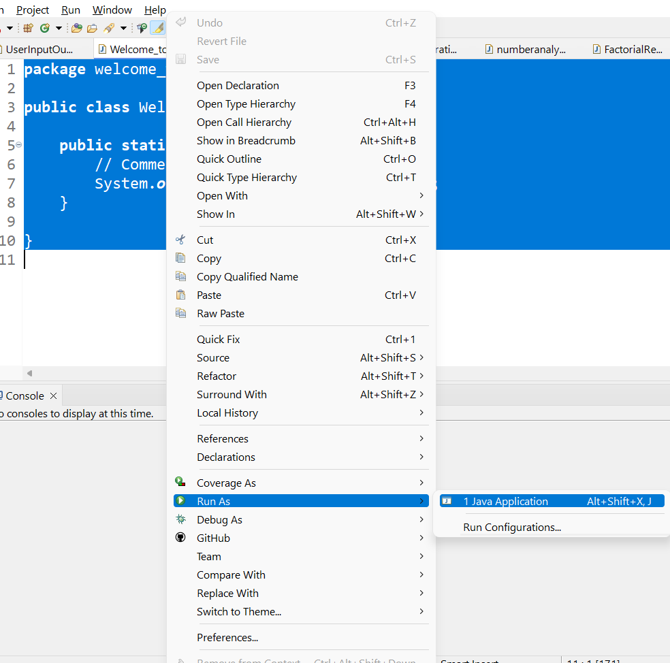
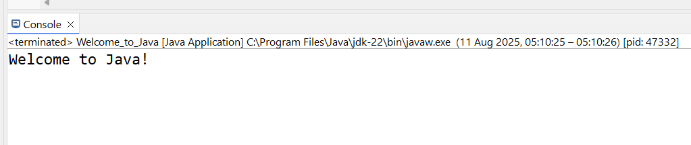
Strings & String Formatting
Run as Java Application (Eclipse)

Slide 36
Arrays
Array = a train carriage with fixed seats for values of the same type.
In Python: list (more flexible).
In Java: fixed size array.
Australian Example:
Array of Sydney train station names: ["Central", "Redfern", "Strathfield"]

Slide 37
Arrays
Python example:
stations = ["Central", "Redfern", "Strathfield"]
print(stations[0])
Java example:
String[] stations = {"Central", "Redfern", "Strathfield"};
System.out.println(stations[0]);
That code doesn’t work by itself in Java because Java doesn’t allow loose statements — everything must be inside a class and usually inside the main method.

Slide 38
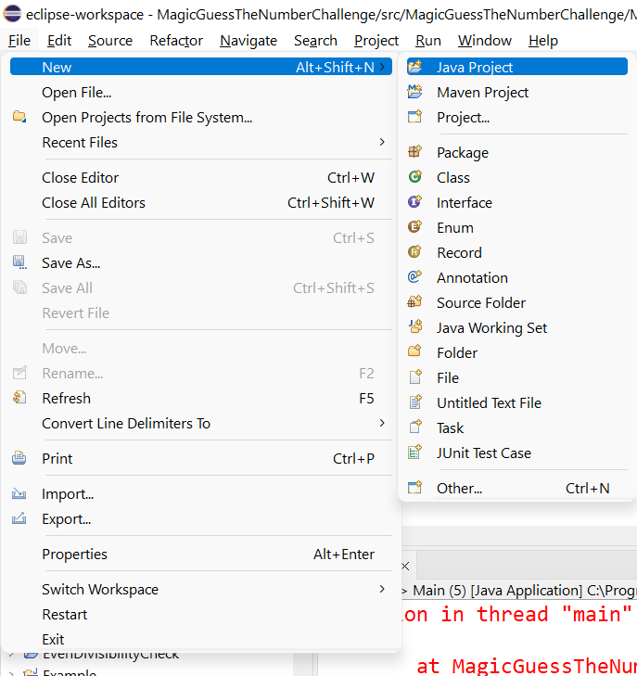
Java Arrays in Eclipse — StationsApp Demo
Create project
File ▸ New ▸ Java Project
Project name: TrainStationsDemo
Uncheck “Create module-info.java” (if shown).
Click Finish.

Slide 39
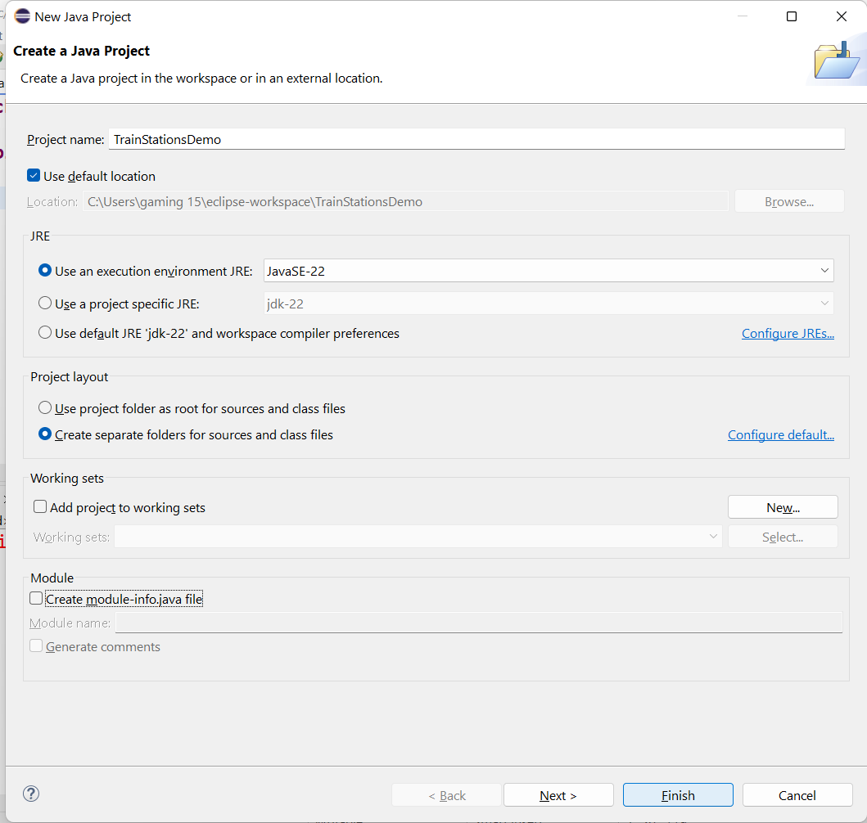
Java Arrays in Eclipse — StationsApp Demo
Create project
File ▸ New ▸ Java Project
Project name: TrainStationsDemo
Uncheck “Create module-info.java” (if shown).
Click Finish.

Slide 40
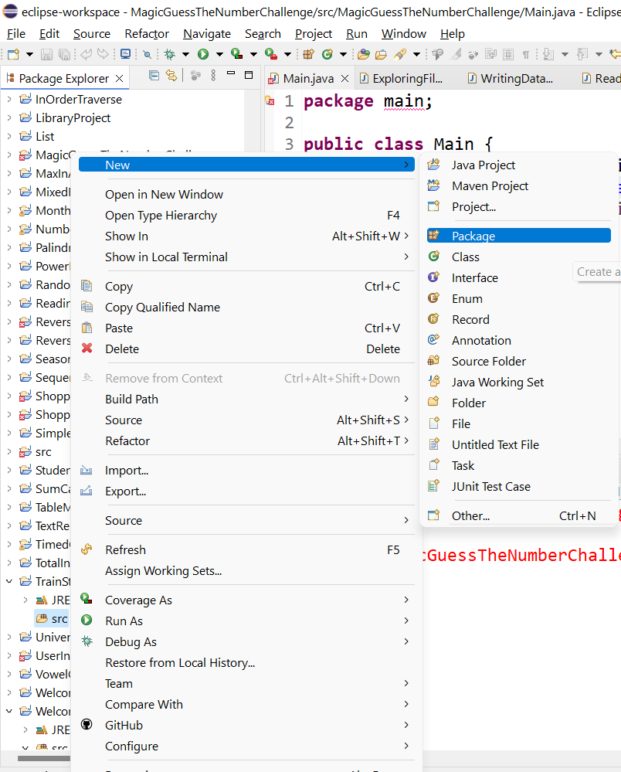
Java Arrays in Eclipse — StationsApp Demo
Make a package
In Package Explorer, right-click src ▸ New ▸ Package
Name: au.sydney.demo ▸ Finish.

Slide 41
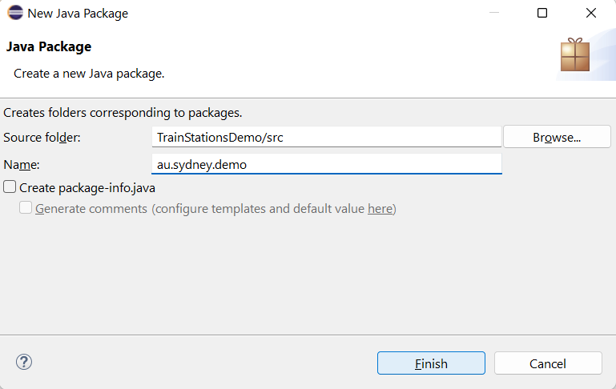
Java Arrays in Eclipse — StationsApp Demo
Make a package
In Package Explorer, right-click src ▸ New ▸ Package
Name: au.sydney.demo ▸ Finish.

Slide 42
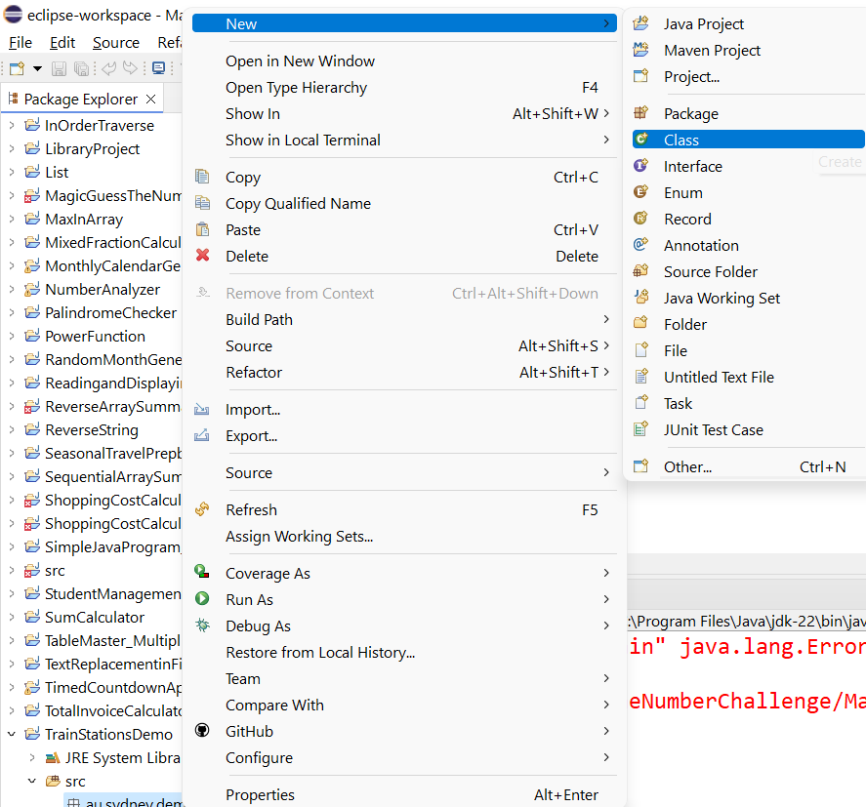
Java Arrays in Eclipse — StationsApp Demo
Add a class with main
Right-click au.sydney.demo ▸ New ▸ Class
Name: StationsApp
Tick public static void main(String[] args) ▸ Finish.

Slide 43
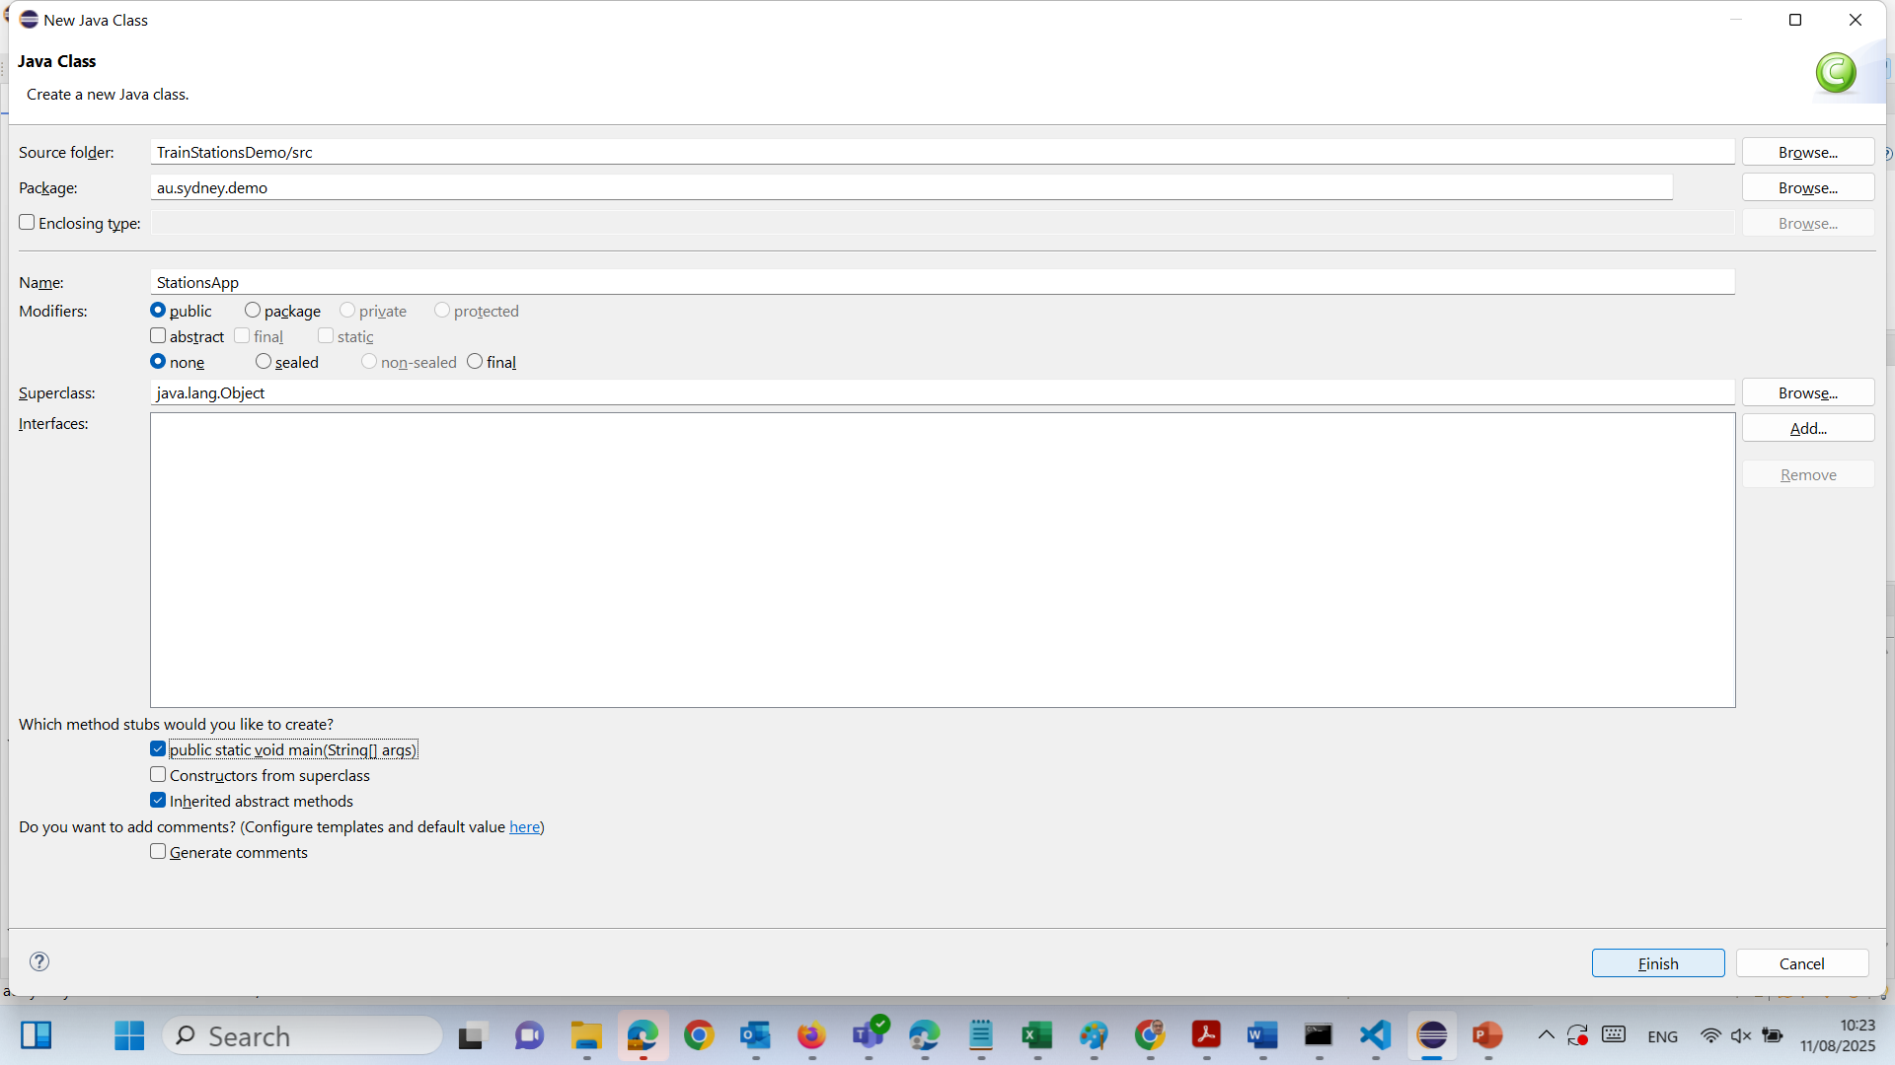
Java Arrays in Eclipse — StationsApp Demo
Add a class with main
Right-click au.sydney.demo ▸ New ▸ Class
Name: StationsApp
Tick public static void main(String[] args) ▸ Finish.

Slide 44
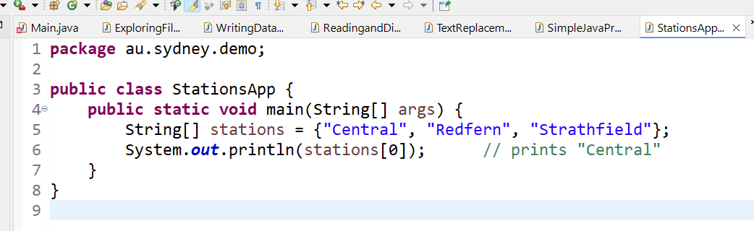
Java Arrays in Eclipse — StationsApp Demo
Add a class with main
Right-click au.sydney.demo ▸ New ▸ Class
Name: StationsApp
Tick public static void main(String[] args) ▸ Finish.

Slide 45
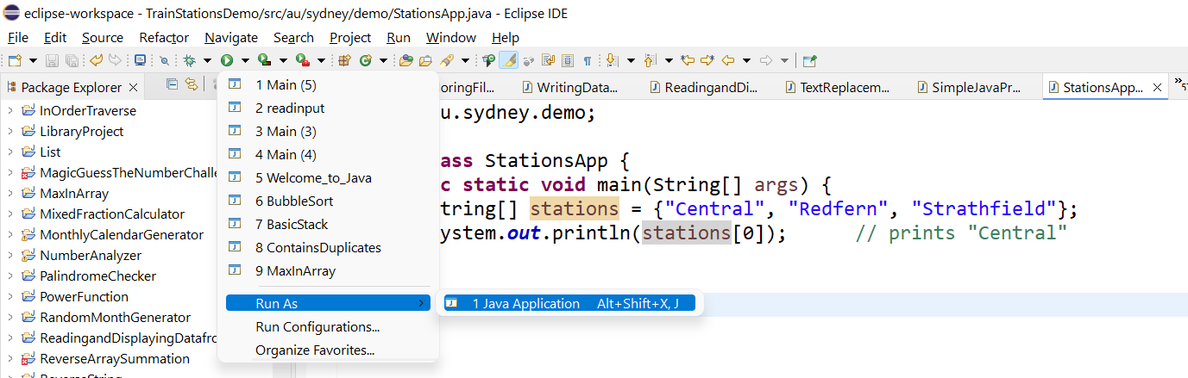
Java Arrays in Eclipse — StationsApp Demo
Run it
Ctrl+S to save → click the green Run button (or Run ▸ Run).
Expected output: Central

Slide 46
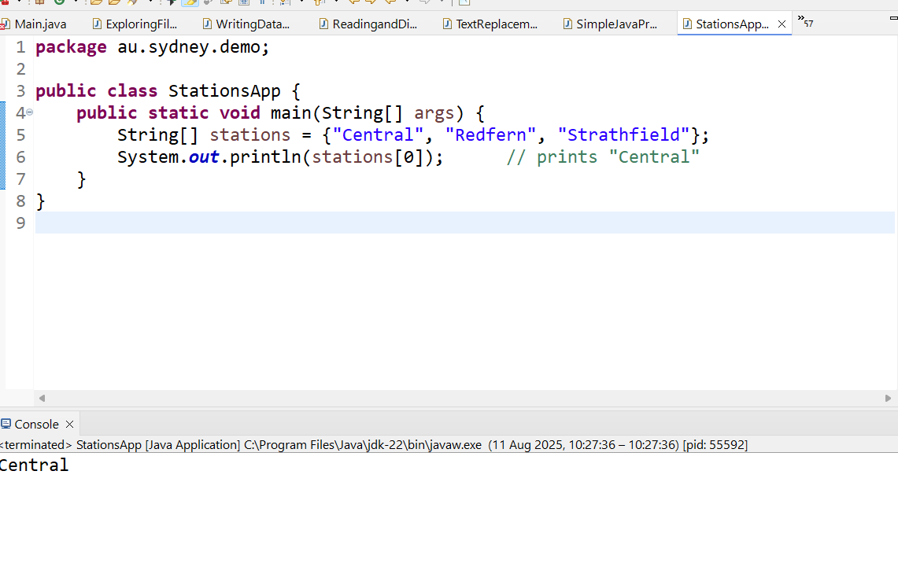
Java Arrays in Eclipse — StationsApp Demo
Run it
Ctrl+S to save → click the green Run button (or Run ▸ Run).
Expected output: Central

Slide 47
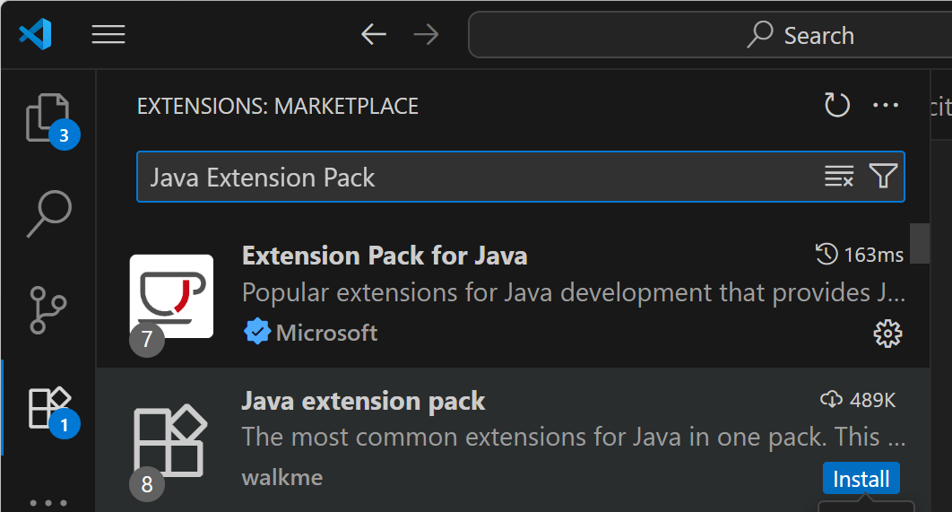
Array Example in Java (Visual Studio Code)- Necessary Package in Visual Studio Code
How to run in Visual Studio Code:
Install the Java Extension Pack from the Extensions Marketplace.
Create a file called Main.java.
Paste the full code above.
Save → click Run Java (or use terminal: javac Main.java then java Main
The first one — Extension Pack for Java by Microsoft.
It’s the official and most complete Java setup for VS Code, and it includes:
Language support (syntax highlighting, IntelliSense)
Debugger for Java
Java Test Runner
Maven and Gradle integration
Project Manager for Java

Slide 48
Input/Output (I/O)
Input = data coming in (keyboard, file)
Output = data going out (screen, file)
Australian Example:
Input: Enter your Opal card balance
Output: Display remaining trips

Slide 49
Input/Output (I/O)
Python Example:
name = input("Enter your name: ")
print(f"Hello, {name}!")

Slide 50
Input/Output (I/O)
Java Example:
import java.util.Scanner;
Scanner sc = new Scanner(System.in);
System.out.print("Enter your name: ");
String name = sc.nextLine();
System.out.println("Hello, " + name + "!");
We need to place this code inside a class with a public static void main(String[] args) method to run it in Java.

Slide 51
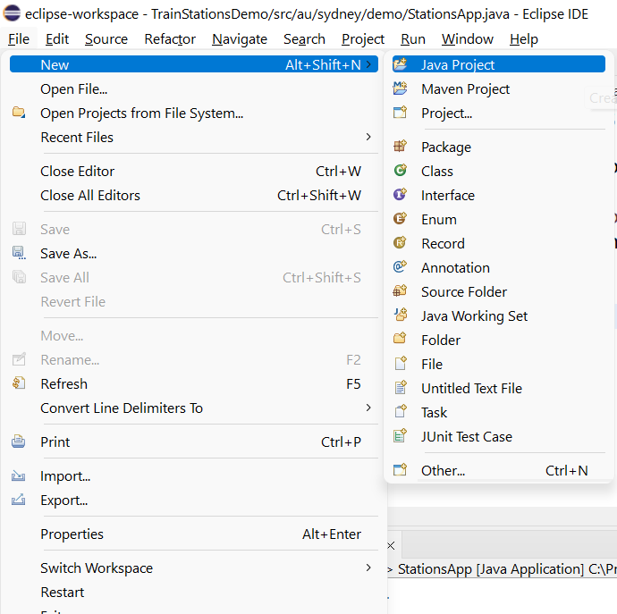
Input/Output (I/O) – Java Example in Eclipse
1) Create a project and class
Open Eclipse → File ▸ New ▸ Java Project → name it (e.g., IntroProgramming) → Finish. (If asked about module-info.java, choose Don’t Create.)

Slide 52
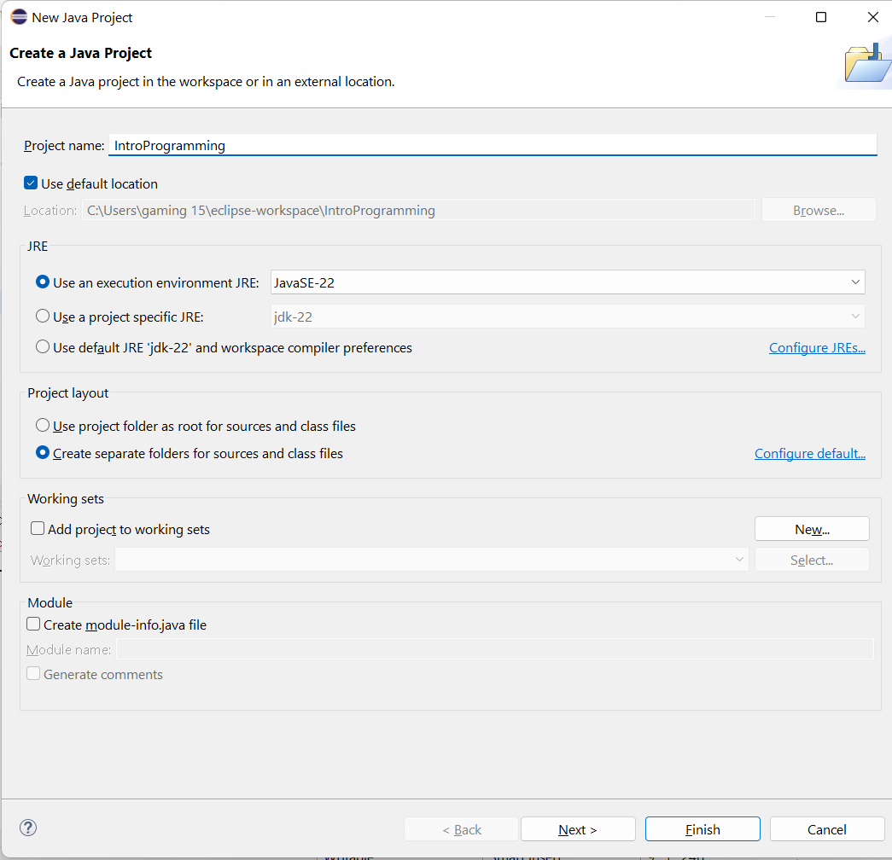
Input/Output (I/O) Input/Output (I/O) – Java Example in Eclipse
1) Create a project and class
Open Eclipse → File ▸ New ▸ Java Project → name it (e.g., IntroProgramming) → Finish. (If asked about module-info.java, choose Don’t Create.)

Slide 53
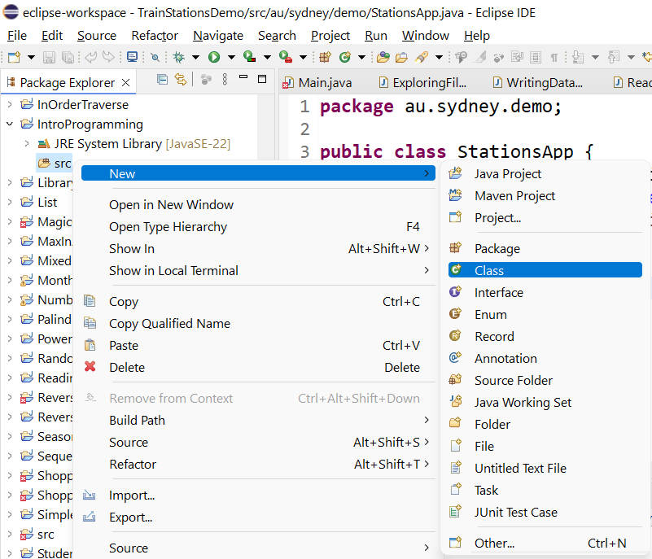
Input/Output (I/O) – Java Example in Eclipse
1) Create a project and class
Open Eclipse → File ▸ New ▸ Java Project → name it (e.g., IntroProgramming) → Finish. (If asked about module-info.java, choose Don’t Create.)

Slide 54
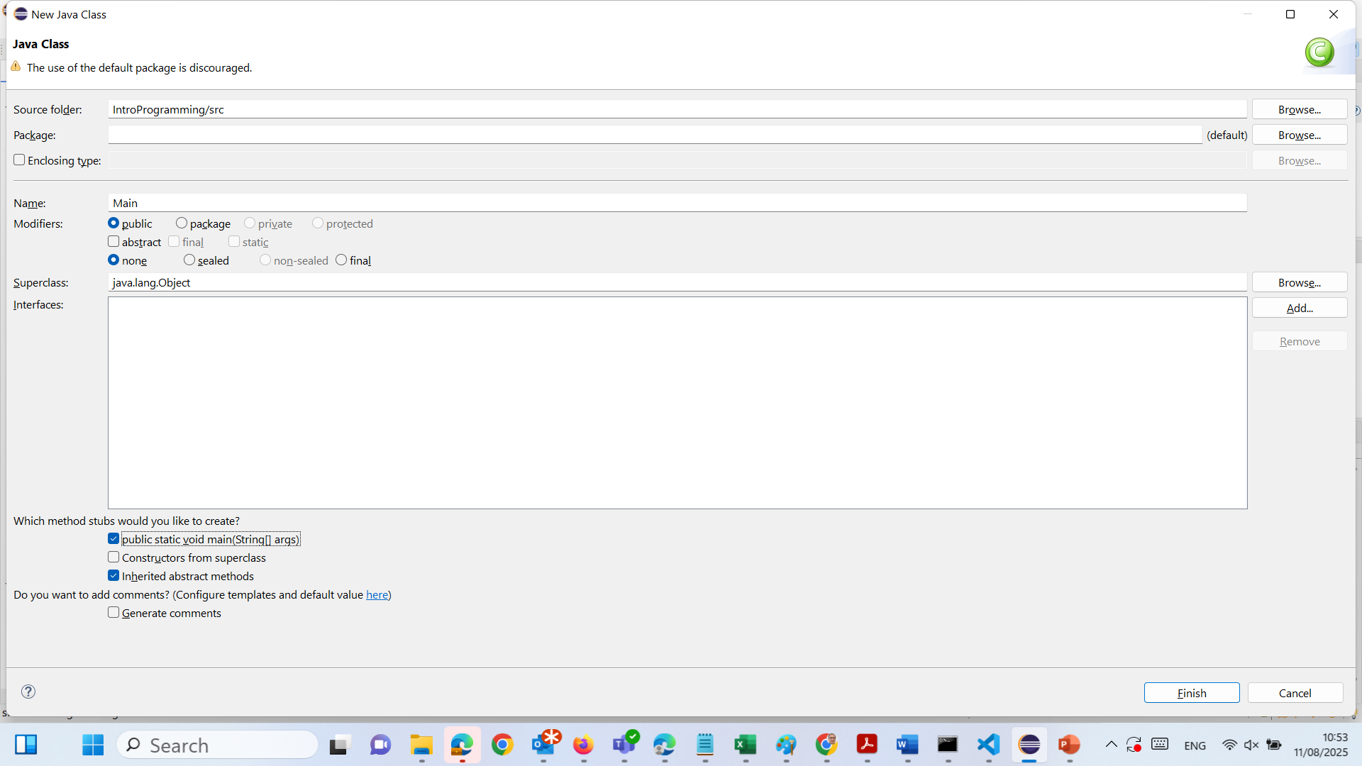
Input/Output (I/O) – Java Example in Eclipse
Right-click src → New ▸ Class → Name: Main → tick public static void main(String[] args) → Finish.

Slide 55
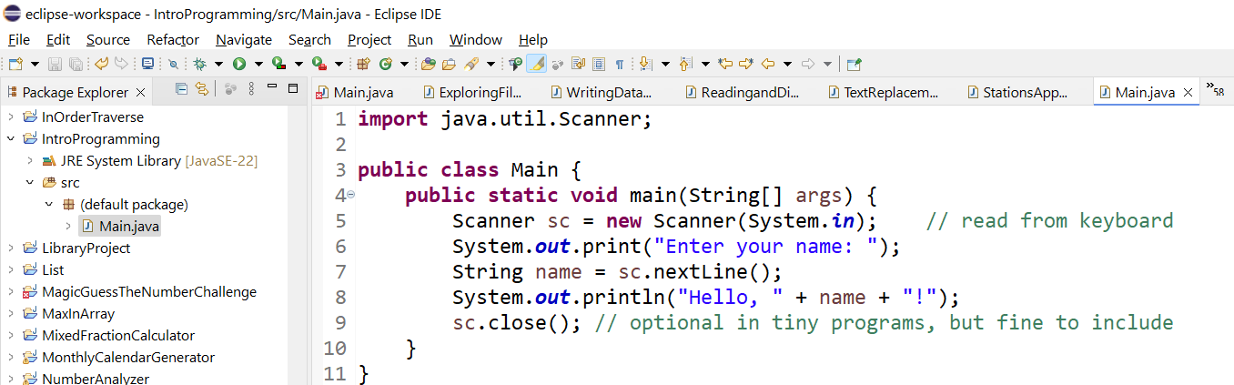
Input/Output (I/O) – Java Example in Eclipse
Right-click src → New ▸ Class → Name: Main → tick public static void main(String[] args) → Finish.

Slide 56
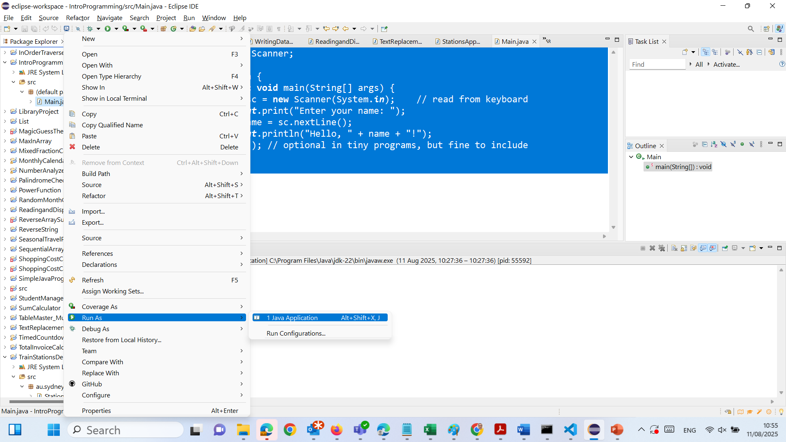
Input/Output (I/O) – Java Example in Eclipse
3. Run it

Slide 57
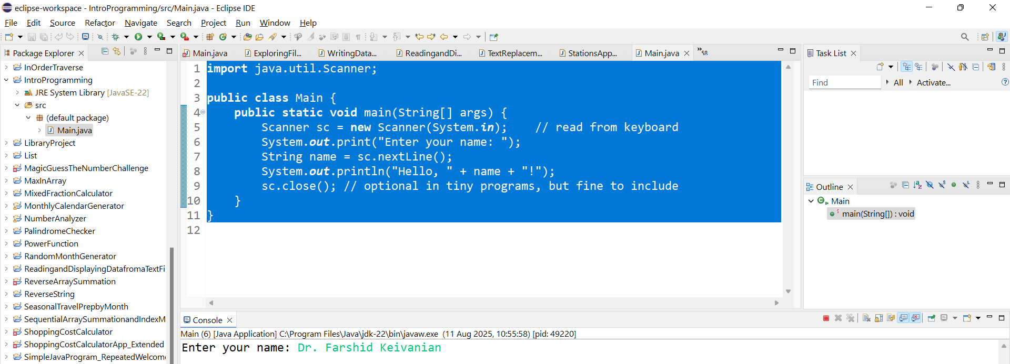
Input/Output (I/O) – Java Example in Eclipse
3. See the Results

Slide 58

Let’s Answer Your Questions
Canvas Inbox – For academic queries.
Email – For formal communication and attachments.
Canvas Discussion – For academic discussions and general queries.
Reminder – Please follow up if you do not receive a response within 3 business days.

Slide 59

Happy Learning and Bright Futures Ahead! Dr. Farshid Keivanian Stay Connected: linkedin.com/in/farshid-keivanian github.com/FarshidKeivanian
Education is the most powerful weapon you can use to change the world. — Nelson Mandela

